Slide 1
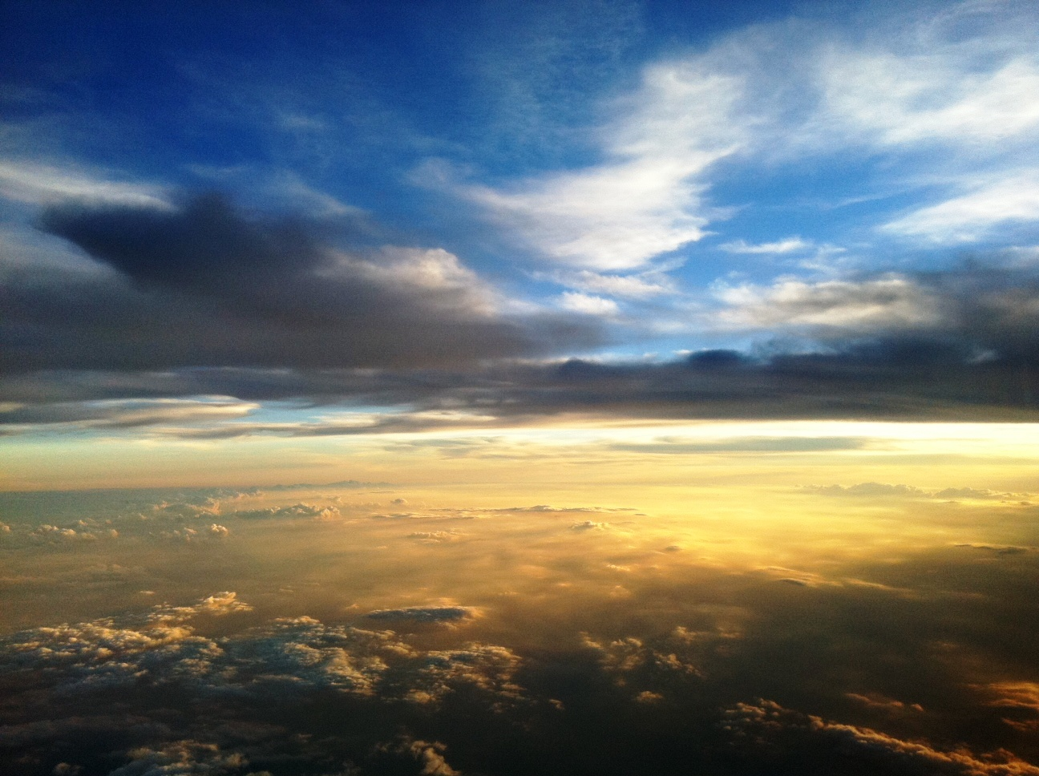


Slide 2

“Paint Me a Picture”
The Bride: Symbol of the Saved in Heaven
Revelation is a book filled with visual symbols (Rev. 1:11, 20, 16; Heb. 4:12; Eph. 6:17).
The sword that comes from the mouth of Jesus is the Word of God, which is used to fight against and conquer the unrepentant (Rev. 2:16; 19:15, 21).
The “Bride” is the church, the body of the saved (cf. 2 Cor. 11:2; Eph. 5:25-27).

Slide 3
“Paint Me a Picture”
Fellowship with God: Destiny of the Redeemed
Heaven is being at home with our heavenly Father!
In the heavenly city, “the tabernacle of God is with men, and He will dwell with them” (21:3).
There is no need to go to a temple to approach God’s presence, for He is always at hand (Rev. 21:22).
Inhabitants are bathed in the light of the glory of His presence (Rev. 21:23, 25).
There is no death, sorrow, crying, or pain because God is present, and He will wipe away every tear (Rev. 21:4).

Slide 4
“Paint Me a Picture”
Only the Holy
Heaven is a place for those who have prepared for their spiritual wedding day (Rev. 21:2,10; Heb. 12:14)
This new realm of existence will be characterized by righteousness (Rev. 21:1, 5, 27; 2 Pet. 3:13).
The “sea” of wicked human society is gone (Rev. 8:8-9; 12:12; 16:3; 18:17-21).
The holy are at home, but the wicked have no place (Rev. 21:27; 20:12, 15; 3:5; 21:8l; Exo. 32:32-33; Phil. 4:3).
The knowledge of this reality does not ruin heaven for God, and it won’t ruin it for the saved either.

Slide 5
“Paint Me a Picture”
The Perfect Home for God’s people
Heaven is our perfect home (Heb. 13:14; 11:10)
The prominence of the number 12 indicates that the city is designed for us! (Rev. 21:12-21) The number twelve symbolizes the people of God.
Jacob had twelve sons whose descendants became the twelve tribes of the nation of Israel; they were the specially chosen people of God (Ezek. 20:5).
Jesus chose twelve apostles and promised them that they would “sit on twelve thrones, judging the twelve tribes of Israel” (Matt. 10:1-5; 19:28).
In Revelation, the number 12 is repeatedly used symbolically for the people of God (Rev. 7; 12:1)

Slide 6
“Paint Me a Picture”
Before the Throne:
Forever In the Presence of a Holy God
The throne of God is a central feature in Revelation’s portrait of heaven (Rev. 21:5; 22:1, 4).
The beauty and glory of the scene focuses our attention on the One who occupies the throne (Rev. 4:2-11).
“Before the throne…”
Prayers and praise ascend (Rev. 8:3; 14:3)
There is a sea of glass and a song of victory (Rev. 15:2-3)
The multitude of the saved glorify God (Rev. 7:8-9)

Slide 7
“Paint Me a Picture”
A Tree by a River and Eternity
In heaven, man regains access to the tree of life (Gen. 3:22-24; Rev. 22:1-2).
The “water of life” flows from the throne (Rev. 22:1; 21:6; 7:17; John 4:14).
“Whoever desires, let him take
the water of life freely.”
(Rev. 22:17)

Slide 8
“Paint Me a Picture”
Impressions of God’s Servants in Heaven
Revelation 22:3-5 indicates the following:
• God’s servants “shall serve Him.”
• God’s servants “will see Him face to face” (John 1:18; 1 John 4:12; 3:2; Exo. 33:20; Matt. 5:8).
• God’s servants will have “His name on their foreheads” (Rev. 7:3; 3:12).
• God’s servants will “reign forever and ever” (2 Tim. 2:12).

